Slide 1
Building a Reactive Form

Slide 2



Slide 3

Module Overview
The Component Class
The Angular Module The Template
Using setValue and patchValue
Simplifying with FormBuilder

Slide 4

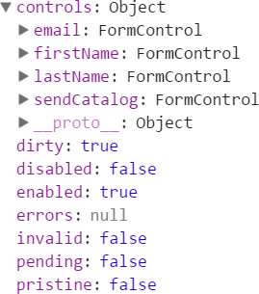

Template-driven vs. Reactive Forms

Slide 5
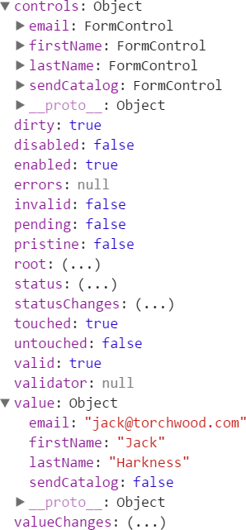
Form Model
Root FormGroup
FormControl for each input element
Nested FormGroups as desired
FormArrays

Slide 6
Creating a FormGroup
customer.component.ts
...
import { FormGroup } from '@angular/forms';
...
export class CustomerComponent implements OnInit { customerForm: FormGroup;
customer: Customer = new Customer();
ngOnInit(): void {
this.customerForm = new FormGroup({ });
}
}

Slide 7
Creating FormControls
customer.component.ts
...
import { FormGroup, FormControl } from '@angular/forms';
...
export class CustomerComponent implements OnInit {
...
ngOnInit(): void {
this.customerForm = new FormGroup({ firstName: new FormControl(), lastName: new FormControl(), email: new FormControl(),
sendCatalog: new FormControl(true)});
}
}

Slide 8
Demo
Building the Form Model

Slide 9

AppComponent
BrowserModule
Customer- Component
Reactive - FormsModule
Angular Module

Slide 10
Binding to the Form Model

Slide 11
Reactive Forms Directives
Reactive Forms
formGroup
formControl
formControlName
formGroupName
formArrayName

Slide 12
formGroup
customer.component.html
<form (ngSubmit)="save()" [formGroup]="customerForm">
...
</form>

Slide 13
formControlName
customer.component.html
<form (ngSubmit)="save()" [formGroup]="customerForm">
<div>
<label for="firstNameId">First Name</label>
<input id="firstNameId" type="text" placeholder="First Name (required)" formControlName="firstName" />
<span ... >
...
</span>
</div>
...
</form>

Slide 14
Accessing the Form Model Properties
customerForm.controls.firstName.valid
customerForm.get('firstName').valid
firstName = new FormControl();
ngOnInit(): void {
this.customerForm = new FormGroup({ firstName: this.firstName,
...
});
}
firstName.valid

Slide 15
Demo
Binding the Template to the Form Model

Slide 16
Using setValue and patchValue
this.customerForm.setValue({ firstName: 'Jack', lastName: 'Harkness', email: 'jack@torchwood.com'
});
this.customerForm.patchValue({ firstName: 'Jack', lastName: 'Harkness'
});

Slide 17

FormBuilder
Creates a form model from a configuration
Shortens boilerplate code Provided as a service

Slide 18
FormBuilder Steps
Import FormBuilder
import { FormBuilder } from '@angular/forms';

Slide 19

FormBuilder Steps
Inject the FormBuilder instance
Import FormBuilder
constructor(private fb: FormBuilder) { }

Slide 20

FormBuilder Steps
Inject the FormBuilder instance
Import FormBuilder
Use the instance
this.customerForm = this.fb.group({ firstName: null,
lastName: null, email: null, sendCatalog: true
});

Slide 21
FormBuilder's FormControl Syntax
this.customerForm = this.fb.group({
firstName: '', sendCatalog: true
});
this.customerForm = this.fb.group({
firstName: {value: 'n/a', disabled: true}, sendCatalog: {value: true, disabled: false}
});
this.customerForm = this.fb.group({
firstName: [''],
sendCatalog: [{value: true, disabled: false}]
});

Slide 22

Checklist: Component Class
Create a property for the root FormGroup
Create the FormGroup instance Pass in each FormControl instance
ngOnInit(): void {
this.customerForm = new FormGroup({ firstName: new FormControl(), lastName: new FormControl(), email: new FormControl(), sendCatalog: new FormControl(true)
});
}

Slide 23
Checklist: FormBuilder
Import FormBuilder
Inject the FormBuilder instance Use that instance
ngOnInit(): void {
this.customerForm = this.fb.group({ firstName: '',
lastName: '',
email: '', sendCatalog: true
});
}

Slide 24
Checklist: Angular Module
Import ReactiveFormsModule
Add ReactiveFormsModule to the imports array
@NgModule({ imports: [
BrowserModule, ReactiveFormsModule
],
declarations: [ AppComponent, CustomerComponent
],
bootstrap: [AppComponent]
})
export class AppModule { }

Slide 25
Checklist: Template
Bind the form element to the FormGroup property
<form (ngSubmit)="save()"
[formGroup]="customerForm">
Bind each input element to its associated FormControl
<input id="firstNameId"
type="text"
placeholder="First Name (required)"
formControlName="firstName" />

Slide 26
The Component Class
The Angular Module The Template
Summary
Using setValue and patchValue
Simplifying with FormBuilder

